Slide 1
The Internet
Part 2: Priorities in Internet Communication

Slide 2

What do we care about in regards to secure communication over the internet?

Slide 3
Aspects of Internet Communication Security
Reliability: Ensure that information arrives uncorrupted.
Confidentiality: Ensure only the intended reader can read the message.
Integrity: Ensure that the message delivered is not manipulated or changed.
Authenticity: Ensure that you are communicating with the desired party.

Slide 4
1.
Compromised Reliability?
Oh no!

Slide 5
DDoS (Compromised Reliability)
Goal: Cut off communication between Alice and Bob.
Packet delays limit how much information can be transferred.
Too much communication leads to Denial of Service.
Think of a traffic jam!
What are DDos Attacks? https://youtu.be/OhA9PAfkJ10
Attack Map: bjc.link/ddosattackmap
How can we protect against this?

Slide 6

Use more servers!*
Use scalable server resources which allow you to use more servers only when you need them.
Notes:
Photo credit to xkcd.com

Slide 7
1.
Compromised Confidentiality?
Oh no!

Slide 8
Eavesdropping*
Remember how many “hops” we saw in TraceRoute.
Each of the computers along the path sees the internet traffic.
How to Hijack Facebook Using Firesheep (No Longer Works!)

Slide 9
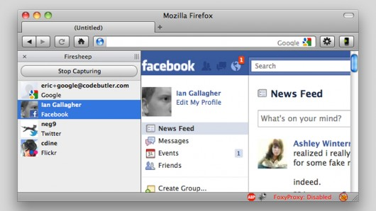
Firesheep allows a user to see all unprotected communication on a network. This included sending passwords and financial data!
Notes:
Photo Credit: www.palaestratraining.com

Slide 10
Eavesdropping*
Remember how many “hops” we saw in TraceRoute.
Each of the computers along the path sees the internet traffic.
How to Hijack Facebook Using Firesheep
How can we protect against this kind of attack?

Slide 11
Encryption
We can protect our information by encoding our traffic with a special key that only lets the owner of that key read the message.
Look for in the URL before entering passwords or any other information you want kept private.

Slide 12
1.
Compromised Integrity?
Oh no!

Slide 13
Data Modification (Compromised Integrity)
Alice wants to make a deposit in Bob’s bank account by sending the amount and Bob’s bank account to the bank website. Eve as usual has access to all communication between Alice and Bob. Eve can intercept and change the account number from Bob’s to her own!
Barack Obama’s Tweets Hacked
How can we protect against this?

Slide 14
Encryption!
Again, encryption can help by making it impossible for Eve to know what part of the message to modify.

Slide 15
1.
Compromised Authenticity?
Oh no!

Slide 16
Spoof!*
As an attacker, we can alter communication to act as someone else. How can we ever know that the person we are communicating with is truly them?
Iran’s Alleged Drone Hack
How could you try to protect against an attack like this?

Slide 17
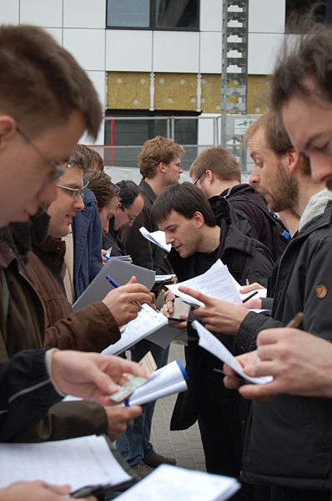
Key Signing Parties! (Extreme Example)
Authenticity is a very difficult aspect to ensure and some go to great lengths to achieve it.
At key signing parties, participants exchange encryption information in person.
Notes:
Photo credit to xkcd.com

Slide 18
1.
Thank you!
See you next week!

